Slide 1
Affordable Housing & Land Use Issues
Planning Association of Washington
October 27, 2017
Megan C. Clark
Etter, McMahon, Lamberson,
Van Wert & Oreskovich, P.C.
618 W. Riverside Avenue, Suite 210
Spokane, WA 99201
Ph. 509-747-9100

Slide 2
Overview
Department of Commerce’s Housing Needs Assessment (2015) – Future figures and Findings
Land Use Factors that Impact Housing Supply
Barriers to Housing Supply
Land Use Tools for Housing Supply & potential legal issues

Slide 3
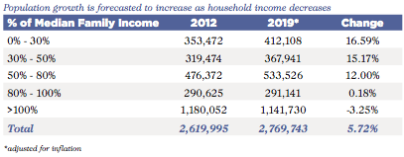
Future figures
Washington’s above-average economic and job growth is expected to continue, resulting in increased population
This population growth over the next 5 years (2015-2020) will be largely driven by low-income households

Slide 4
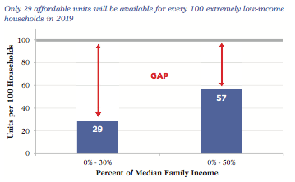
Housing gap is shrinking, but slowly
Number of housing units priced for low income households is forecasted to grow at a similar but slightly faster rate than the number of low income households
Gap of 43 affordable and available housing units per 100 low income households in 2019

Slide 5
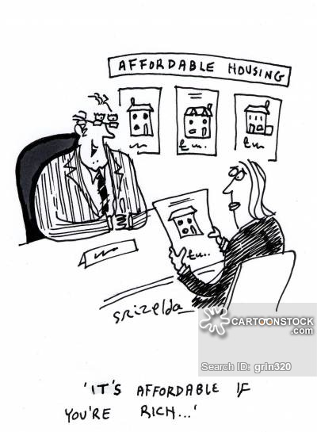
Barriers to Housing Supply
Lack of resources
Higher-end housing is more profitable
Expensive lots lead to expensive housing
Extending infrastructure is expensive
Resistance to growth at the jurisdictional and individual level

Slide 6
Land Use Tools for Housing Supply
Basis: Growth Management Act, RCW 36.70A.
Policies must “encourage the availability of affordable housing to all economic segments of the population.” RCW 36.70A.020(4).
Inclusionary Zoning
Bonus densities
Housing Innovations Program
Fee waivers, reductions, and other altered changes
Multi-family tax exemptions

Slide 7
Inclusionary Zoning
Legal Basis
RCW 36.70A.540 - Affordable Housing Incentives Program Act
Any city or county planning under RCW 36.70A.040 may enact or expand affordable housing incentive programs providing for the development of low- income housing units through development regulations or conditions on rezoning or permit decisions, or both, on one or more of the following types of development: Residential; commercial; industrial; or mixed-use. An affordable housing incentive program may include, but is not limited to, one or more of the following:
(i) Density bonuses within the urban growth area;
(ii) Height and bulk bonuses;
(iii) Fee waivers or exemptions;
(iv) Parking reductions; or
(v) Expedited permitting.
Zone change must further local growth management and housing policies
Ordinances that require a given share of new construction to be affordable by people with low to moderate incomes

Slide 8
Inclusionary Zoning
RCW 36.70A.540 likely permits jurisdictions to adopt both mandatory and voluntary incentive zoning programs
WAC 365-196-870
Counties and cities may establish an incentive program that is either required or optional
Most common inclusionary zoning
Mandatory set asides
Voluntary incentive programs

Slide 9
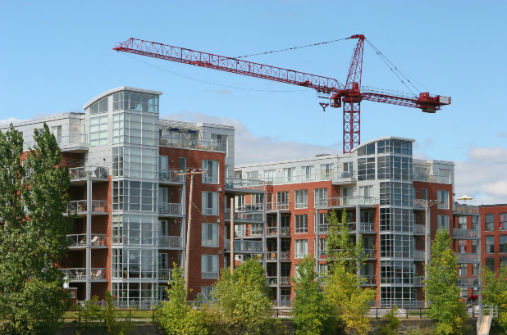
Inclusionary Zoning - Mandatory
Mandatory inclusionary zoning regulations usually specify the following:
Minimum quantity of affordable units
Targeted income range of households to be served
Time period within which the designated units must be maintained as “affordable”
Geographic scope of such regulations

Slide 10
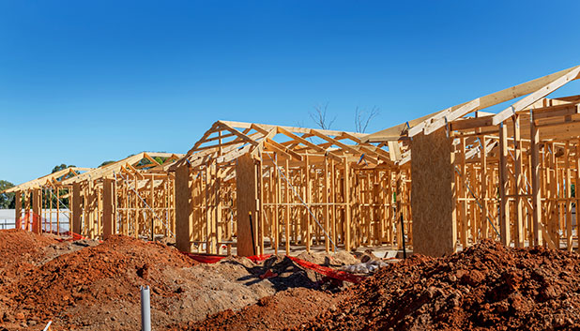
Inclusionary Zoning
Pros
Production of more affordable housing for low income residents
Mix of income levels
Cons
Difficult to administer
Change in community character
Weak housing market

Slide 11
Inclusionary Zoning – Challenges
Takings:
“Nor shall private property be taken for public use, without just compensation” – U.S. Const., 5th Amendment
“No private property shall be taken or denied for public or private use without just compensation, having been first made, or paid into court for the owner.” WA. Const. art. I, § 16.
San Telmo Associates v. City of Seattle, 108 Wn.2d 20 (1985)
R/L Associates v. City of Seattle, 113 Wn.2d 402 (1989)

Slide 12
Inclusionary Zoning - Challenges
Due Process – Procedural and Substantive
Procedural
“At least a meaningful opportunity to be heard in a meaningful time.” Mathews v. Eldrige, 424 U.S. 319 (1979).
Substantive
Legitimate public purpose
Uses reasonable means necessary to achieve the purpose
Unduly burdensome to property owner

Slide 13
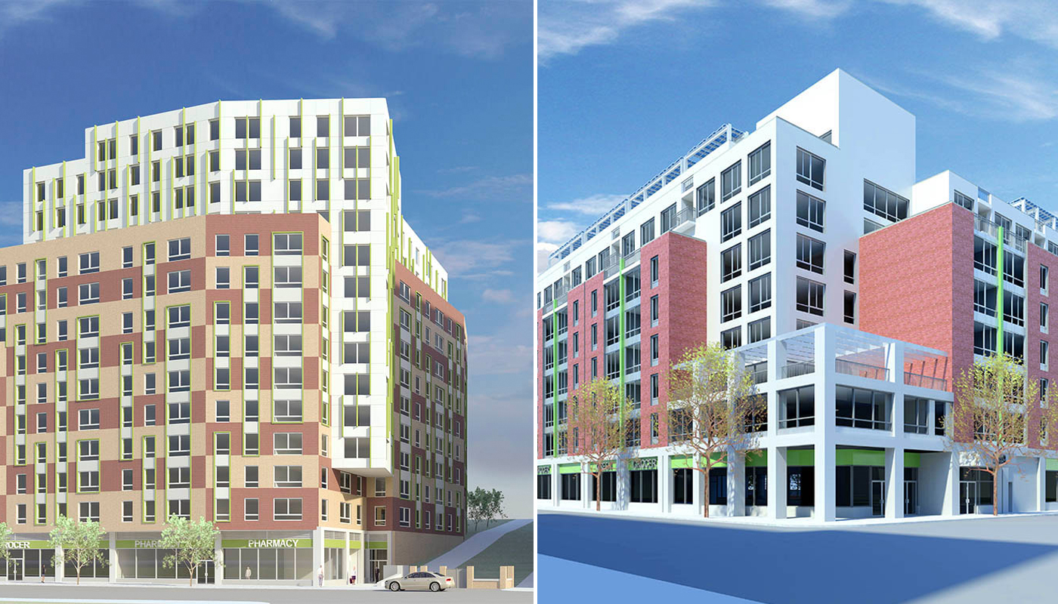
Bonus Densities
Increase in density over the otherwise maximum allowable residential density
No cost to local government
Examples:
Bellingham – Ch. 20.27
Federal Way – Sec. 19.110.010
Marysville – Ch. 22C.090
King County – Ch. 21A.34
Pierce County – Ch. 18A.65

Slide 14
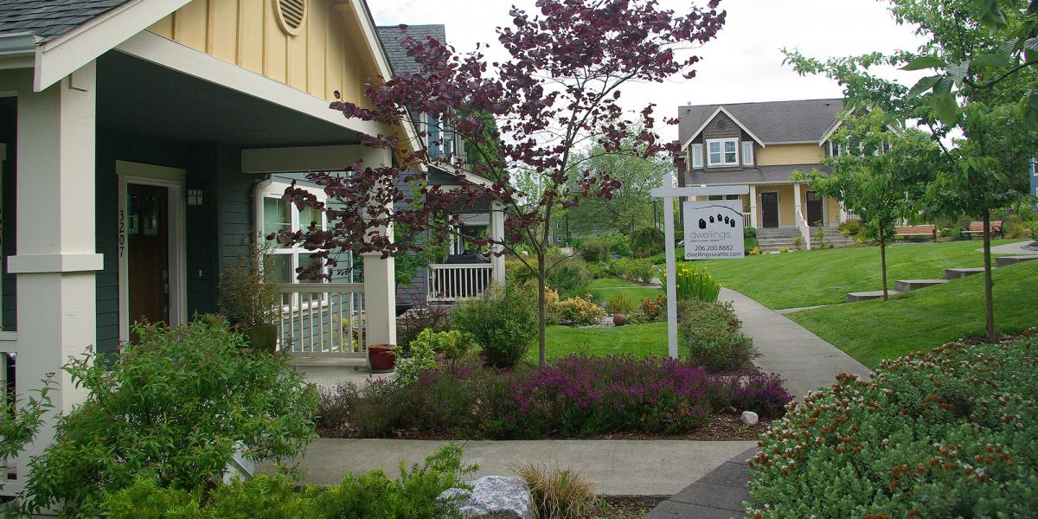
Housing Innovations Program (HIP)
Trial period
Cottage Housing, small lot development, townhomes, cluster development, among others
Examples
Bellingham Municipal Code Ch. 20.27
Kirkland Zoning Code Ch. 113
Redmond Zoning Code Sec. 21.08.360

Slide 15
Fee Waivers, Reductions, or Other Altered Charges
Examples:
Impact fee exemptions (RCW 82.02.060(2))
Discounted building or planning fees
Reduced sewer and water connection fees
Reductions from certain development requirement (such as required parking spaces)
Allow modification of dimensional requirements (such as setbacks and building height)
Additional units possible
Provide flexibility that reduces construction costs
Streamlined review process

Slide 16
Multi-Family Tax Exemption
RCW 84.14
Population of 15,000 or more may establish a tax exemption program to stimulate the construction of new, rehabilitated, or converted multi-family housing within designated areas, including affordable housing
Value of eligible housing improvements exempted from property taxes for 8-12 years
Exemptions: land, existing improvements, nonresidential improvements
Examples
Bellingham Municipal Code Ch. 17.82.030
Spokane Municipal Code Ch. 8.15
Yakima Municipal Code Ch. 11.63

Slide 17
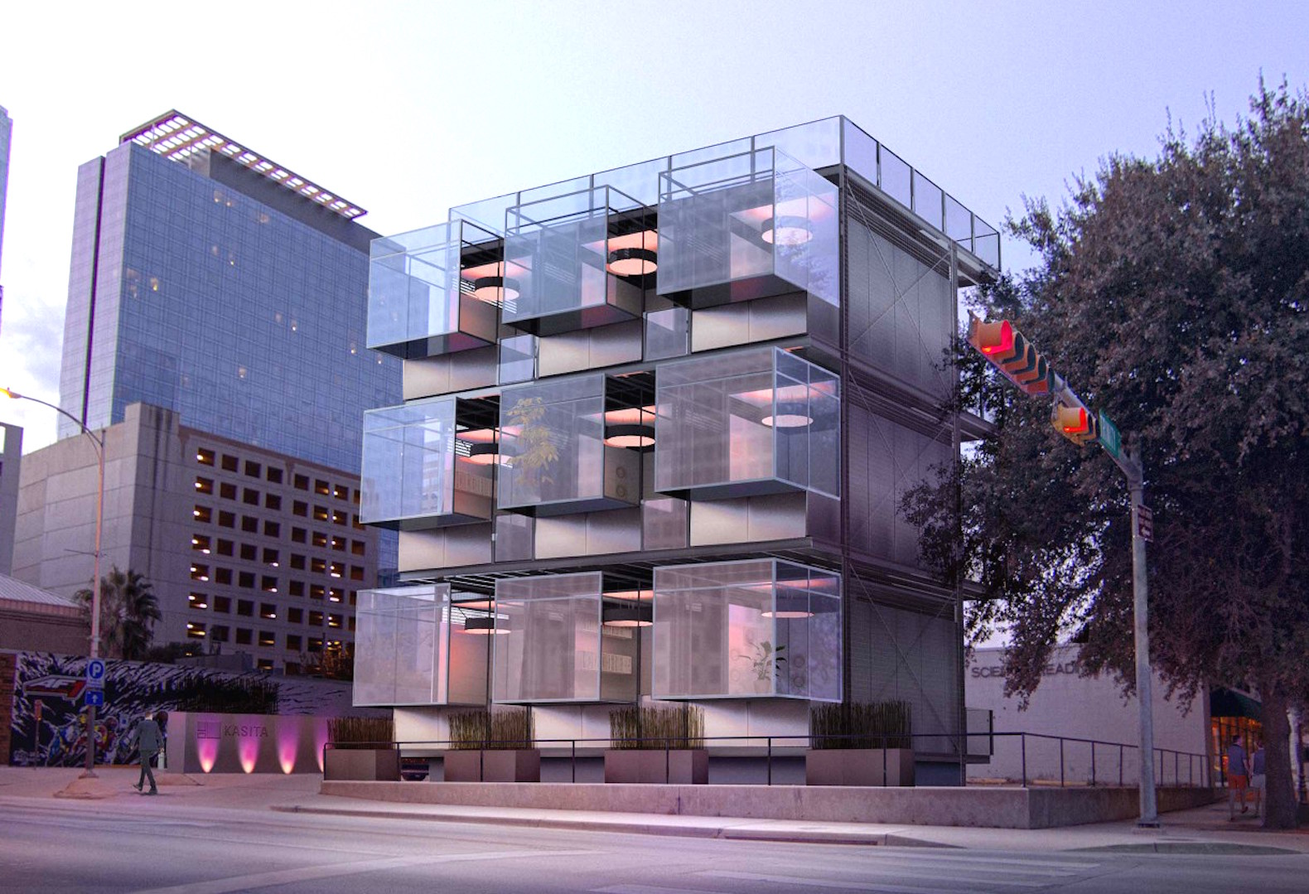
Other Planning Approaches
Efficient use of housing
Accessory dwelling units
Micro-Housing
Green, low-income housing

Slide 18
Relevant Case Law
Low Income Housing Institute v. City of Lakewood, 119 Wn. App. 110 (2003)
Reversed a Board’s dismissal of a Petition to Review the City of Lakewood’s comprehensive plan because the Board failed to address whether and how the plan met RCW 36.70A.020’s affordable housing goals
Diehl v. Mason County, 94 Wn. App. 645 (1999)
Affirmed a Board’s invalidation a County’s comprehensive plan which, in part, failed to adequately address affordable housing

Slide 19
What Else Can We Do?
Provide funding to local governments to plan for housing at every income level
Support local government to assess land capacity through buildable land reports
Provide broad-based education to encourage communities to facilitate the development of more affordable housing
Further research

