Slide 1
Using your Housing Element to Increase Housing Affordability: The Needs Assessment & Tools That Work
Friday, October 27th, 2017
Planning Association of Washington

Slide 2
Focus for Today
Sharing models and resources that build on housing need and gap and illuminate housing elements and implementation of strategies

Slide 3
Who is HDC?
HDC exists solely to serve as an advocate, broker and convener of and for our 150 member organizations and businesses.
Since its inception over 29 years ago, HDC and our members have known that it takes a unique set of personal and professional skills to increase the effectiveness, visibility, and impact of the affordable housing sector.
Mission: Through education, advocacy and leadership, HDC supports and inspires its members as they work collaboratively to meet the housing needs of limited-income people throughout King County.
Notes:
HDC only exists to serve our members, and in this context, we like to talk about the A B Cs. As an ADVOCATE, we represent the collective voice of our membership and the movement. We also work hard to BROKER meaningful relationships that foster new business, create greater efficiencies, and generally benefit our member base, and finally we provide the platform and the space for our members to interact, share best practices, and network as a CONVENING agent of the sector.

Slide 4
Every King County community needs affordable homes
No city in King County is meeting the proportional need for homes affordable to households at or below 30% AMI
Gaps are largest in Seattle, North King County, and East King County
What does your city need?

Slide 5
HDC Housing Data Maps
Interactive maps of city-level housing data, regularly updated to reflect the latest information
Illustrates publicly available data and original research on affordable housing need and policy opportunities
Offer easy visual comparison and promising practices

Slide 6
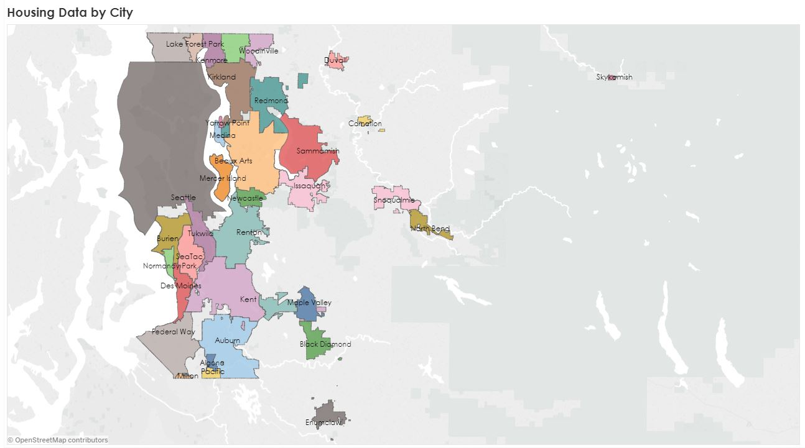
HDC Housing Data Maps

Slide 7
Housing Facts Map
www.housingconsortium.org/maps
Data sourced from:
All Home Point-in-Time (PIT) Count
American Community Survey (ACS)
HUD Comprehensive Housing Affordability Strategy (CHAS)
King County Comprehensive Plan 2016, Technical Appendix
Zillow Rent Index and Median Home Values

Slide 8
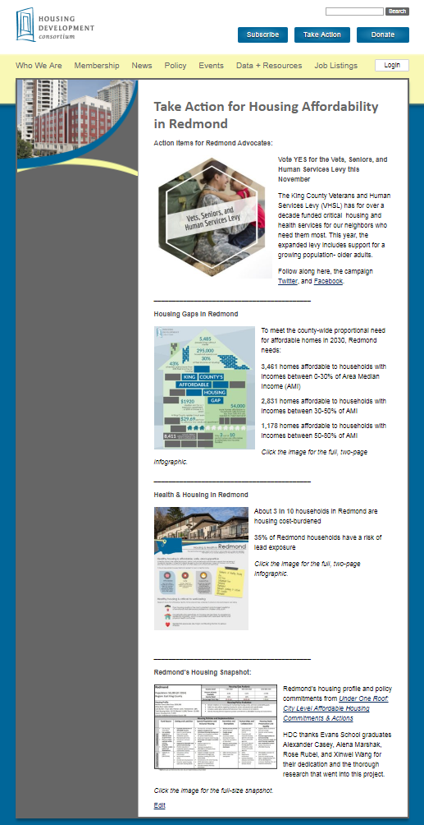
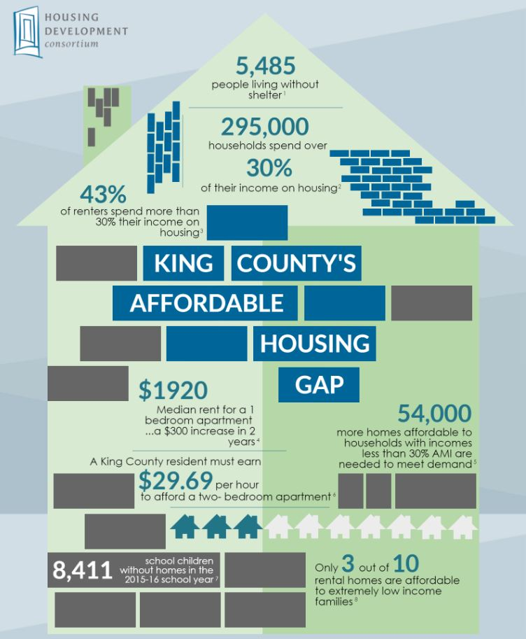
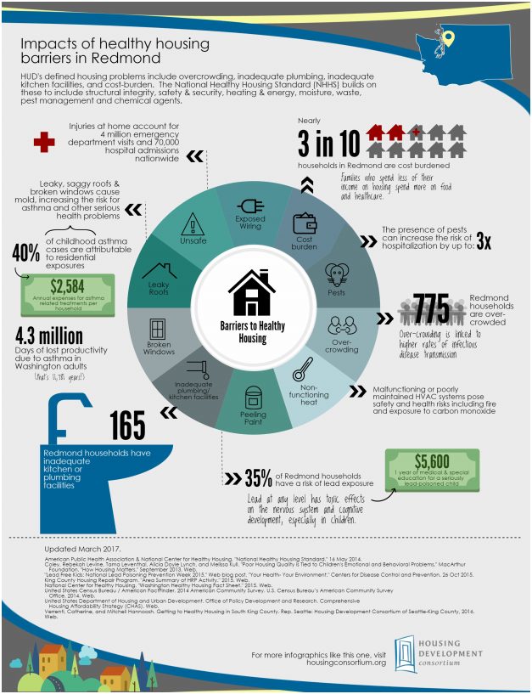
Action Items
Targeted actions for residents of every King County city and major CDP
Infographics
Engaging illustrations on housing supply and the nexus of health & housing

Slide 9
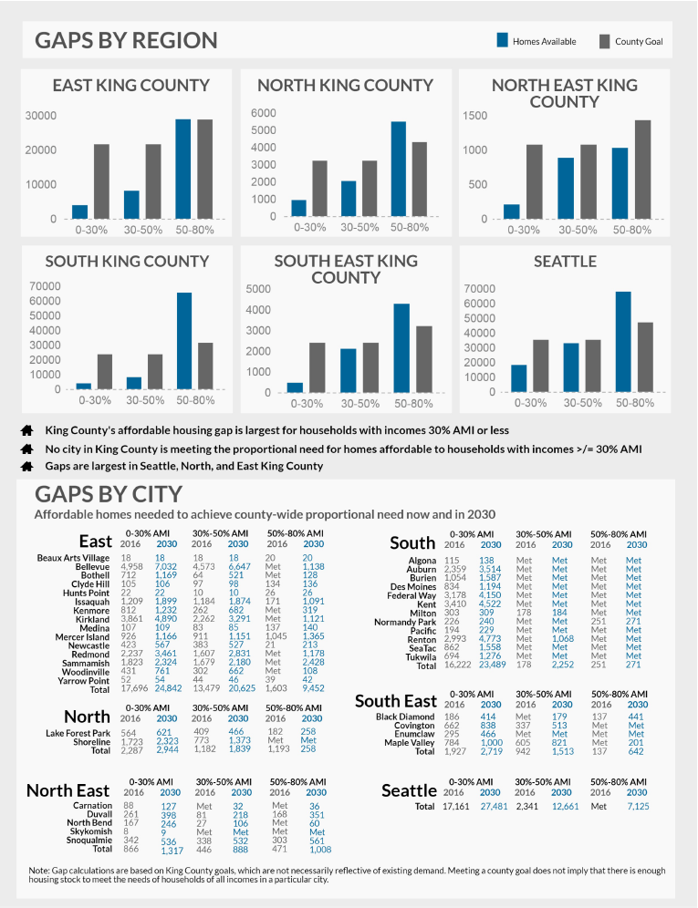

Slide 10
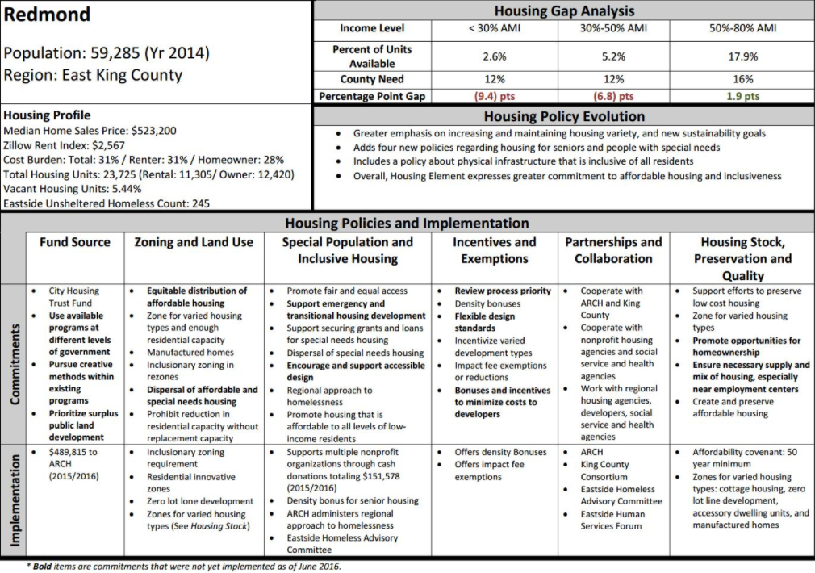

Slide 11
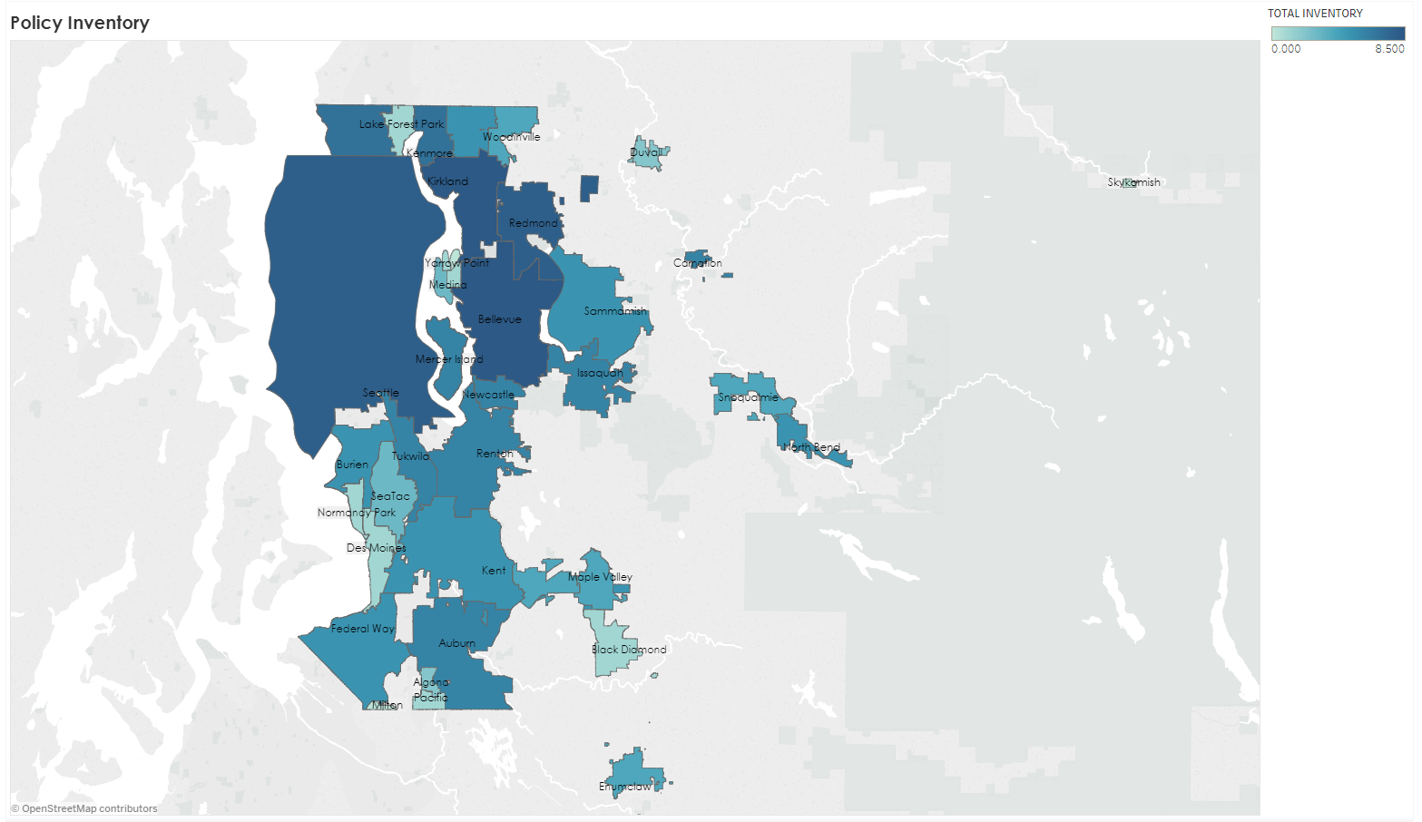
HDC Policy Inventory Map

Slide 12
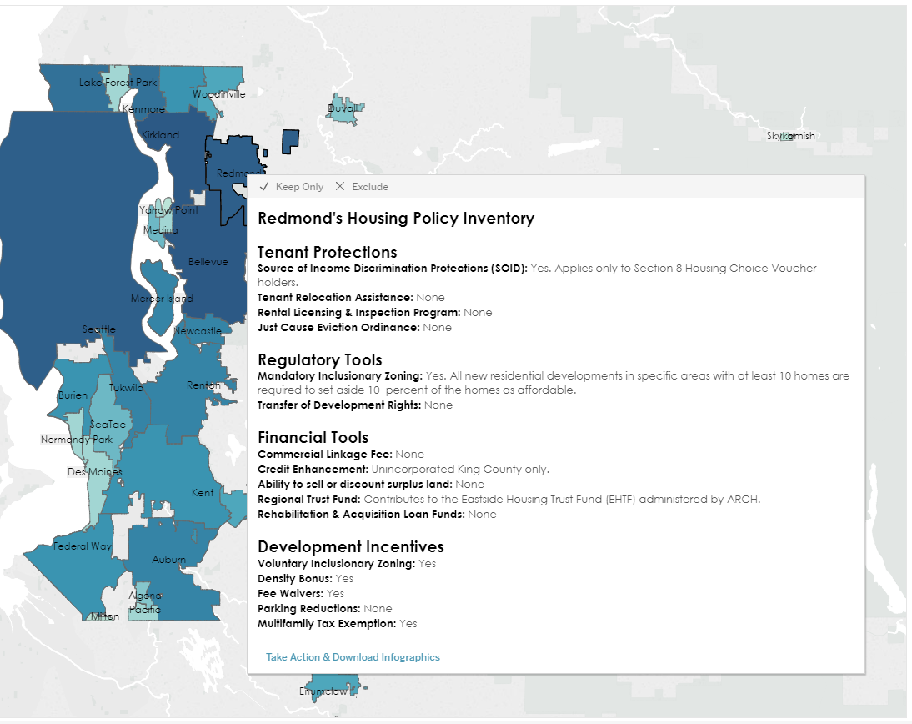
Policy Inventory Map
www.housingconsortium.org/maps
Sourced from municipal codes
Notes:
HDC tracks city ordinances

Slide 13
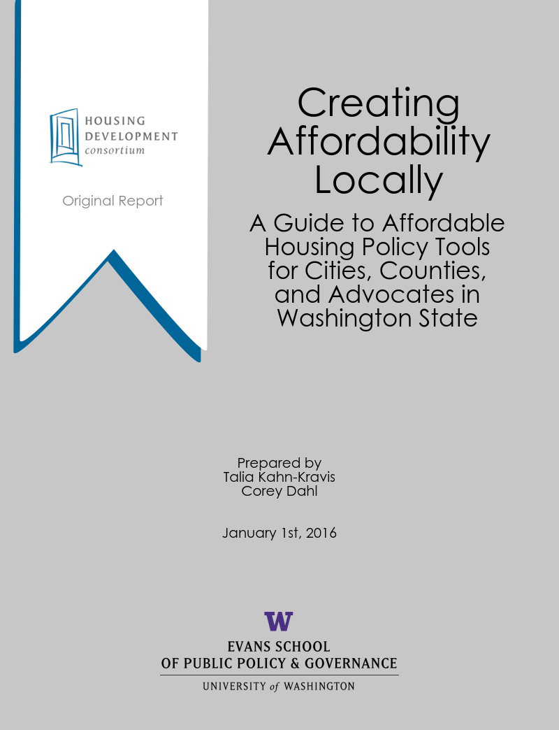
Filling the Gaps: Local Solutions to Match Local Context
Non-Regulatory Actions
Community Education & Awareness Building
Development Incentives or Requirements
Financing
Other

Slide 14
Comprehensive Plan Housing Element
Local Comprehensive Plans must include a Housing Element that:
(a) includes a needs assessment
(b) includes a statement of goals, policies, objectives, and mandatory provisions for the preservation, improvement, and development of housing
(c) identifies sufficient land for housing
(d) makes adequate provisions for existing and projected needs of all economic segments of the community.
Local Comprehensive Plans must also be consistent with Countywide Planning Policies and regional policy documents (ie: Metropolitan Planning Organization documents like PSRC’s Vision 2040).
Some cities also complete a Strategy Plan.

Slide 15
Non-Regulatory Actions
Education & Community Engagement
Strategy Task Force
Partnerships
State and Federal Advocacy

Slide 16
Development Incentives or Requirements
MFTE
Inclusionary/Incentive Zoning
Commercial Linkage Fee
Impact Fee Exemption
Reduced Parking Requirements

Slide 17
Financing
Housing Trust Funds & ARCH
Housing levies
HB 2263
Mental Illness & Drug Dependency sales tax
Real Estate Excise Tax (REET)

Slide 18
Choices, Choices, Choices
 | Taxing Source | Action | Jurisdiction | Authorizing Leg
Housing Levy | Property Tax | Voter approval | City or County | RCW 84.55
HB 2263 | Sales Tax | Voter approval | County, cities after 2 years (3 years in King County) | RCW 82.14
REET | Tax on the sale of real estate | Council approval | City | Not yet authorized for affordable housing

Slide 19
Other Strategies
Tenant Protections
Tenant Relocation and Assistance Ordinance
Just Cause Eviction Ordinance
Section 8 Anti-Discrimination Ordinance
Access to Housing Legislation, HALA
Preservation
Rental Inspections
Acquisition/Code Enforcement Loan Program
Preservation Property Tax Exemption
Accountable Communities of Health

Slide 20
Putting It All Together
Comp Plan
Station Planning
Policy Change
Strong support for affordable housing
Transit investment provides opportunity for policy change
Inclusionary Housing, Impact Fee Exemption, Permit Fee Waiver

Slide 21
Resources
A Regional Coalition for Housing (ARCH)
Commerce Short Course on Local Planning
GMA Website
HDC Maps
MRSC – Planning
PSRC Housing Guides and Resources
Seattle Housing Affordability and Livability Agenda (HALA)

Slide 22
Contact Info
Housing Development Consortium Seattle-King County
Executive Director: Marty Kooistra, marty@housingconsortium.org
(206) 682-9541
1402 Third Avenue, Suite 1230
Seattle, WA 98101

Slide 23
Thank you!

